Slide 1

SHiP shield optimization
Artem Filatov
Higher School of Economics, Yandex School of Data Analysis

Slide 2
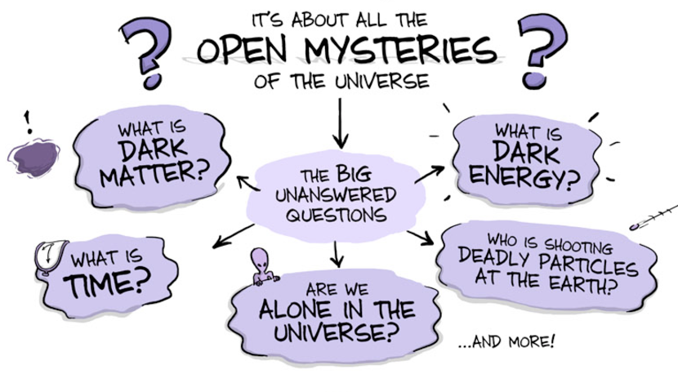
SHiP experiment

Slide 3
SHiP experiment
Many theoretical ideas which predict dark matter, and which can be
tested experimentally.
SHiP is designed to find a solution for new physics by searching for very weakly interacting particles of the low mass.

Slide 4
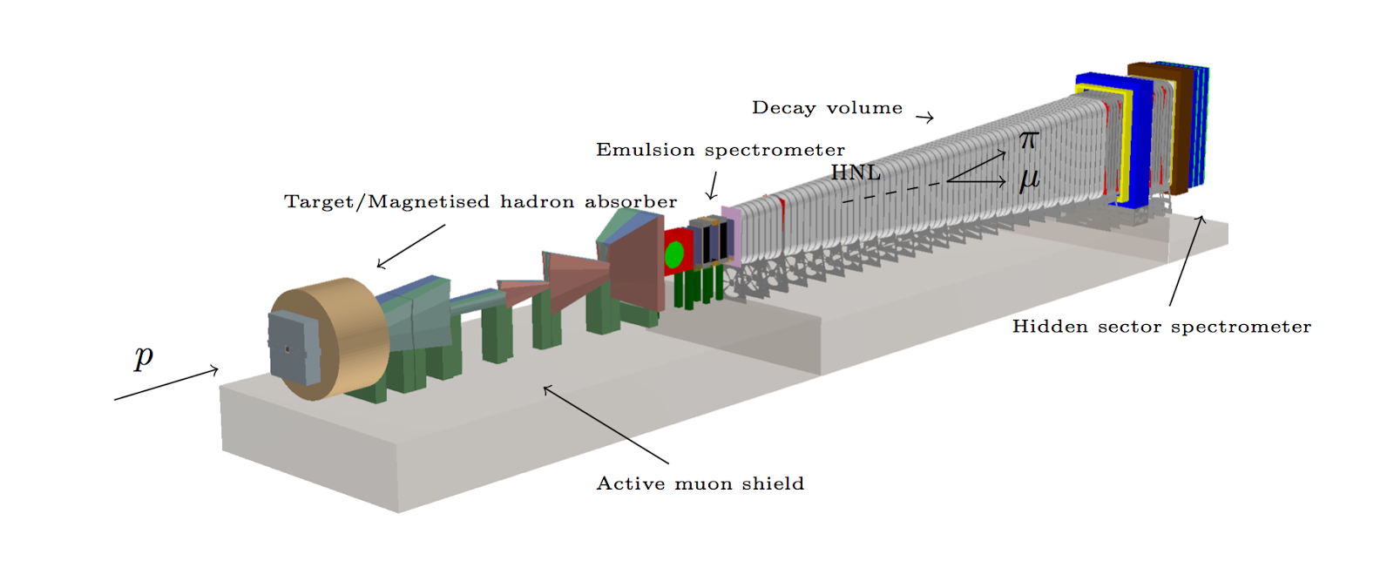
SHiP experiment

Slide 5
SHiP shield

Slide 6
SHiP shield
The experiment needs to minimize backgrounds from all known particles.
Critical part is the deflection of muons by a magnetic shield.

Slide 7
SHiP shield
The shield contains 8 magnets and each magnet parametrized by 7 values.
It cost about 4000 $ per ton.
We need to find a cheap and efficient solution which minimize backgrounds.

Slide 8
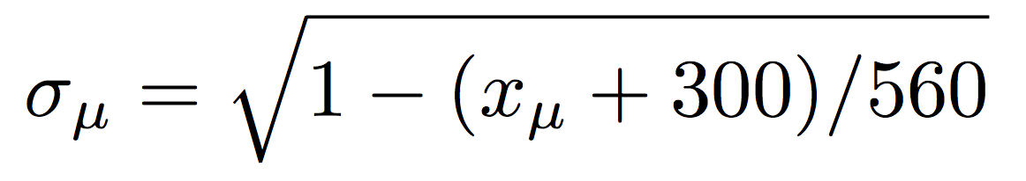
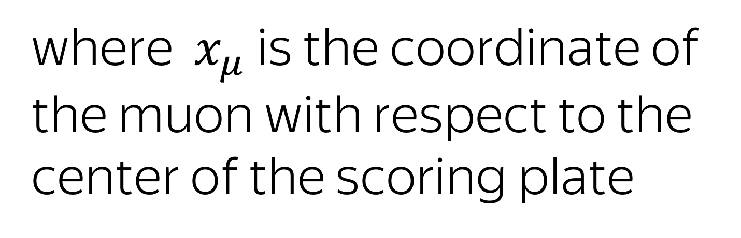
Evaluation of the shield
For given configuration we can make MC simulations.
17.8M muons pass thought the shield.
For every muon we can compute the following value
where $x_{μ}$ is the coordinate of the muon with respect to the center of the scoring plate
Notes:
17.8M

Slide 9
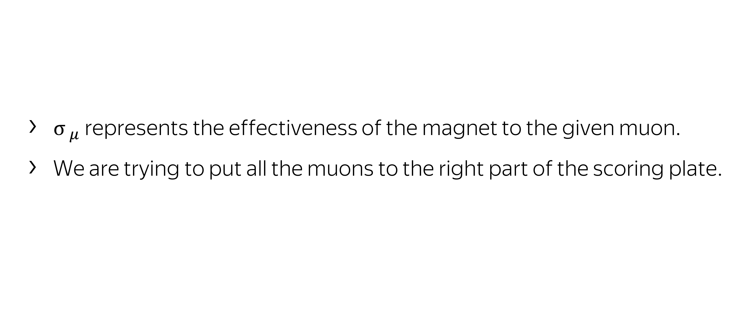
$${σ }_{μ}$$
${σ }_{μ}$ represents the effectiveness of the magnet to the given muon.
We are trying to put all the muons to the right part of the scoring plate.

Slide 10
Loss function
We need to formalize the notion of a good configuration in some function.
Let design loss function which reflects our views about best solution.

Slide 11
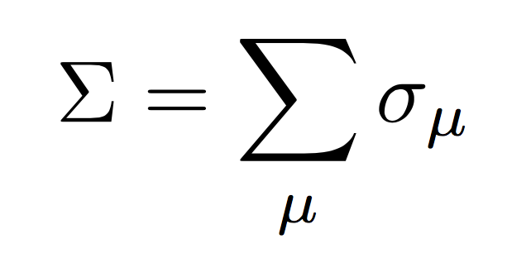
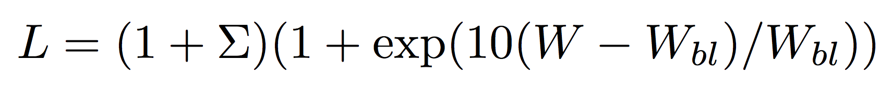



Loss function
We can measure performance of the shield by $Σ$ value, which is computed over all muons $μ$.
We design loss function that depends on the$Σ$, weight $W$ and some fixed weight $W_{bl}$.
Our goal is to minimize $L$.

Slide 12
Baseline configuration

Slide 13
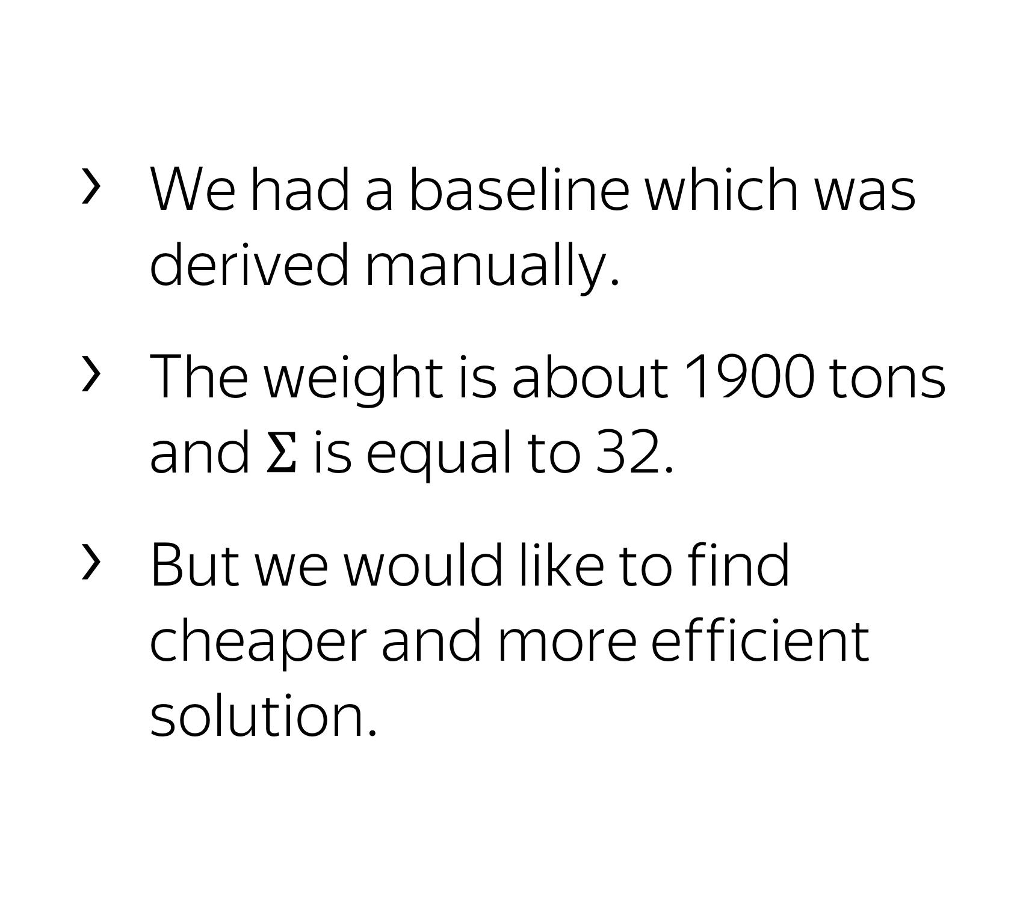
Baseline
We had a baseline which was derived manually.
The weight is about 1900 tons and$Σ$is equal to 32.
But we would like to find cheaper and more efficient solution.

Slide 14
Our approach: Bayesian Optimization

Slide 15
Optimization cycle
Build a surrogate model over loss function.
Choose next point according to surrogate model via probabilistic methods.
Compute next point.

Slide 16
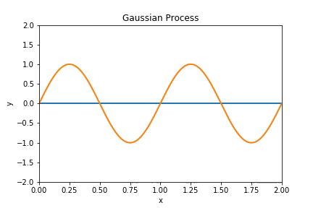
Surrogate modeling
Surrogate models
Gaussian Processes
Random Forest
Gradient Boosting

Slide 17
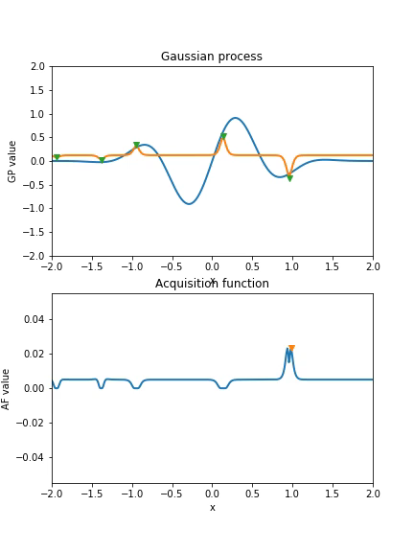
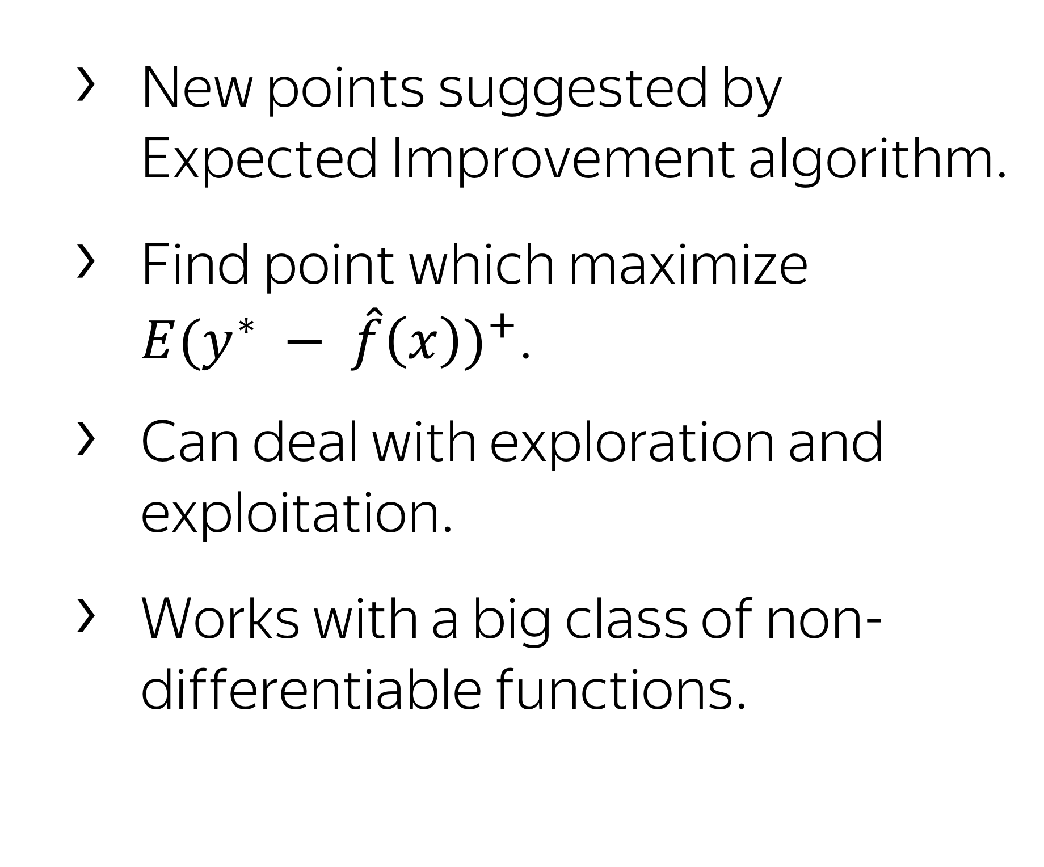
Expected improvement
New points suggested by Expected Improvement algorithm.
Find point which maximize ${E(y^{∗} − \hat{f}\left(x\right))}^{+}$.
Can deal with exploration and exploitation.
Works with a big class of non-differentiable functions.

Slide 18
Optimization results

Slide 19
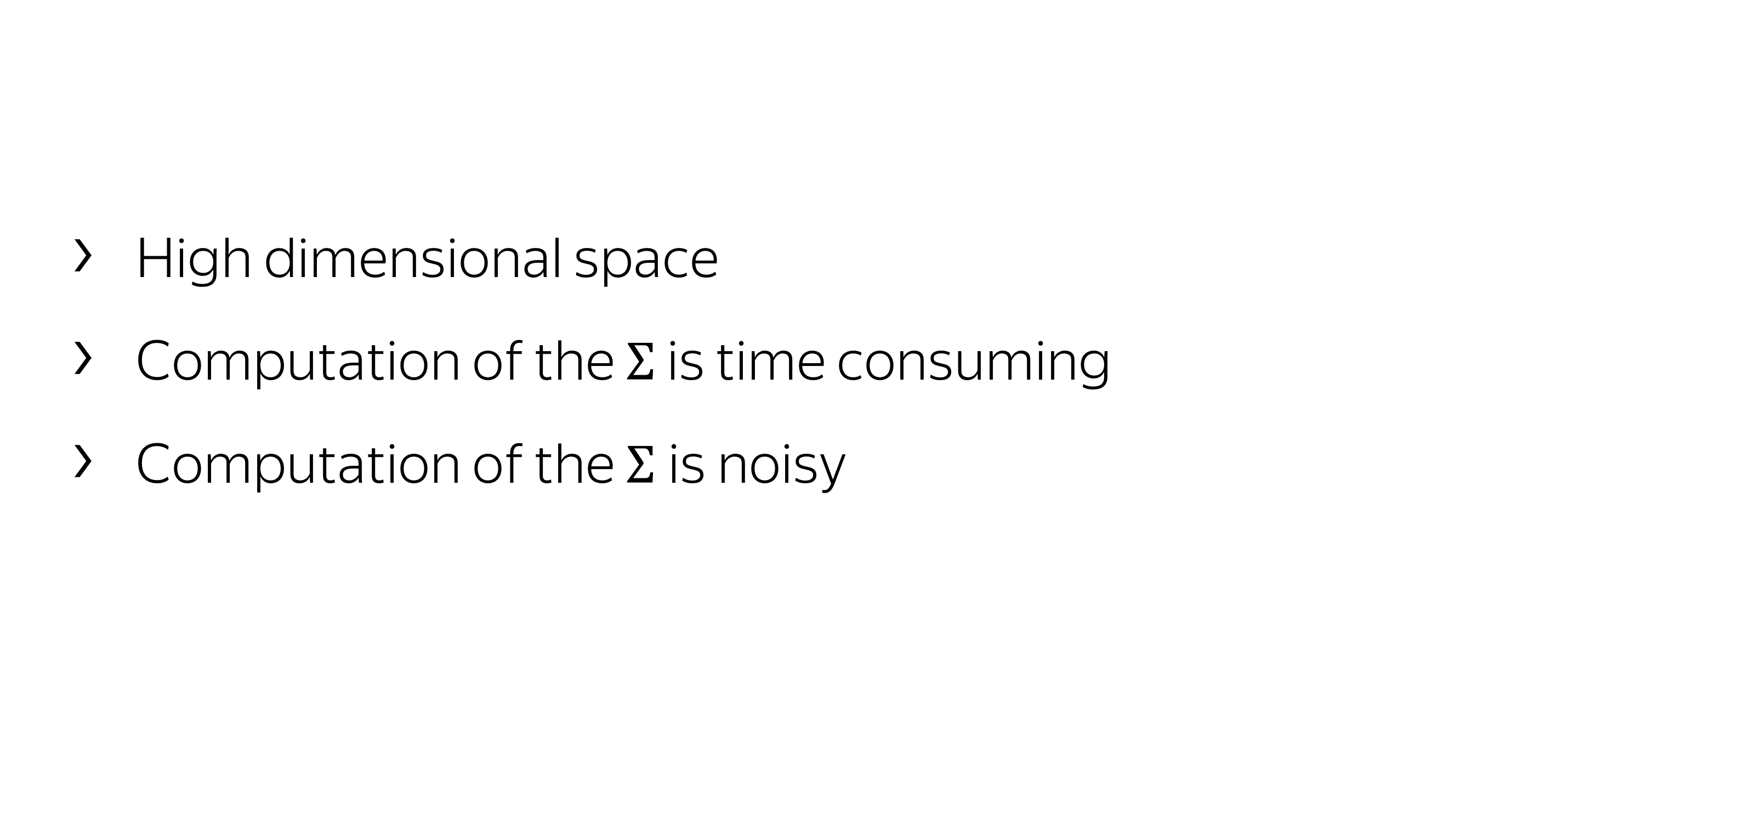
Difficulties
High dimensional space
Computation of the $Σ$ is time consuming
Computation of the $Σ$is noisy

Slide 20
Initial setup
To increase the speed of computation we made simulations only with ‘bad’ muons.
Discard many low-momentum muons. Finally we left only 485K muons.
For computations we have used a large distributed system, as task is well-parallelized.

Slide 21
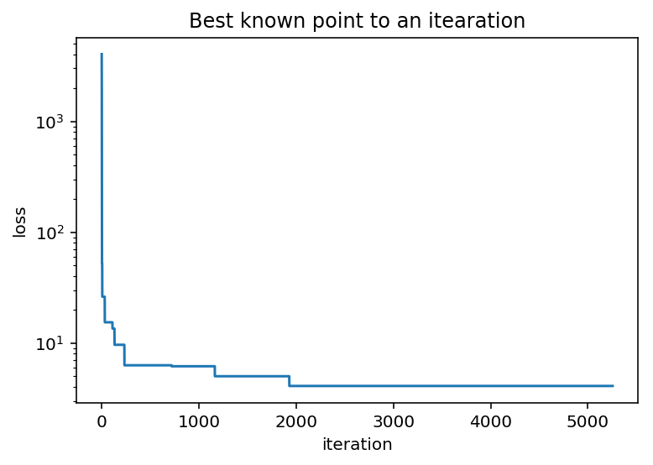
Optimization run
Optimization started from light rectangular configuration.
Points was computed in batches.
After 5000 points we stated a result.

Slide 22
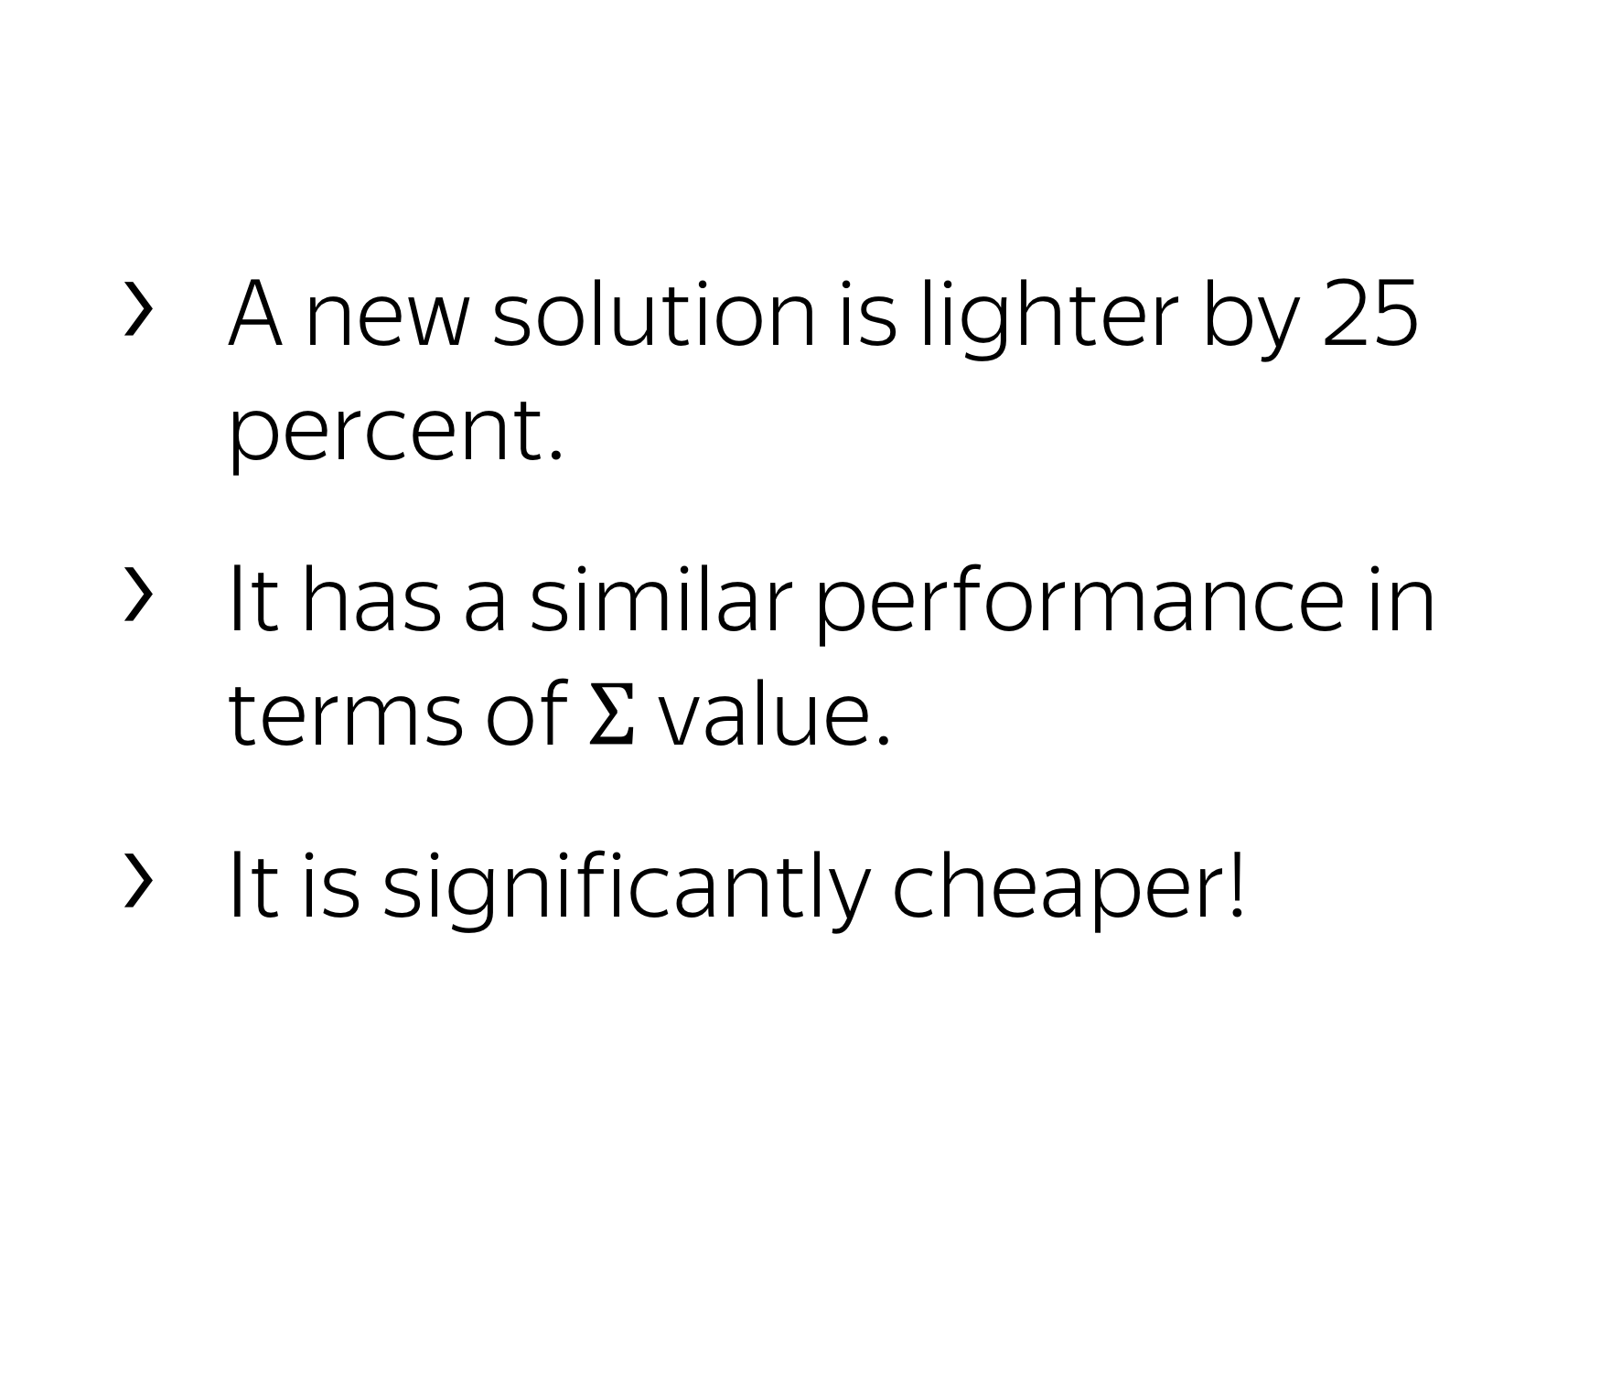
Results
A new solution is lighter by 25 percent.
It has a similar performance in terms of $Σ$ value.
It is significantly cheaper!

Slide 23
Conclusion
Bayesian Optimization works and solution was found.
We can optimize a lot of non-differentiable tasks, e.g. physical experiments.

